Slide 1

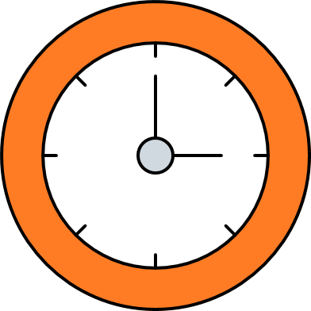
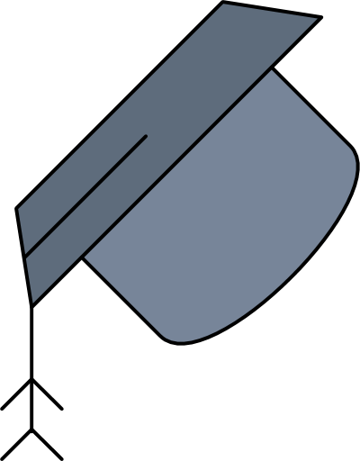





DRDO
NLP &
Transformer’s
BY : Arjun Pandey
Date:12/07/2024

Slide 2
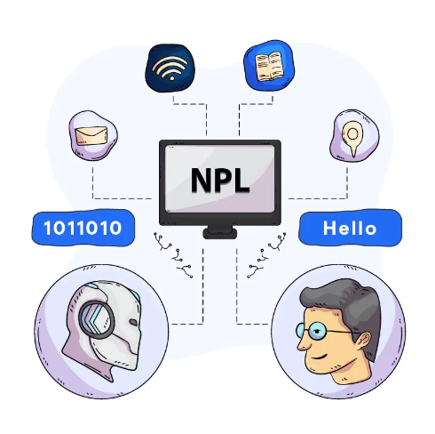


Contents
Introduction NLP
01
02
RNN & LSTM
Transformer
03
04
Architecture

Slide 3
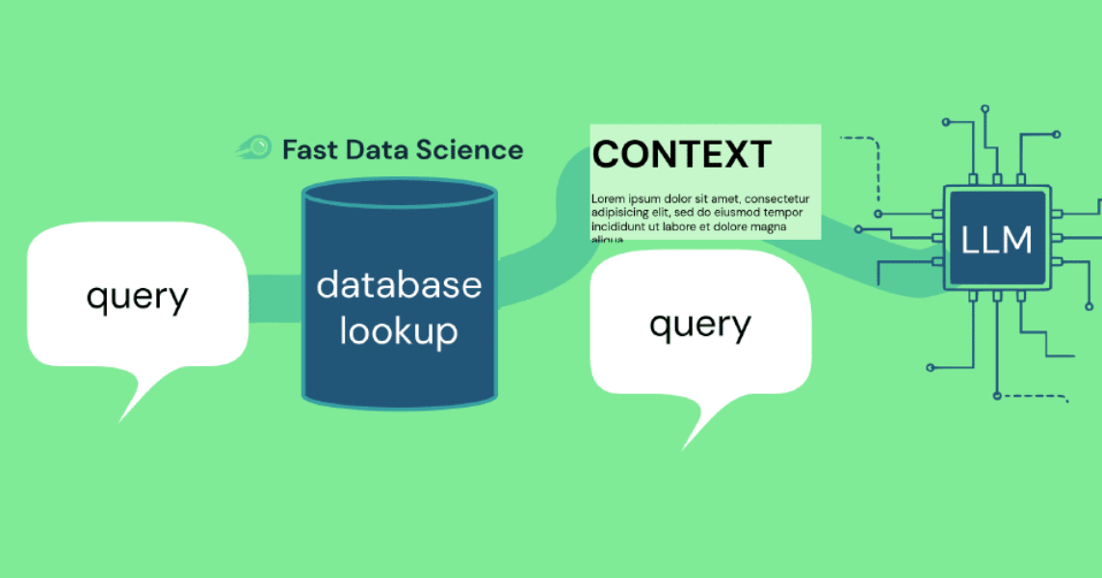
01
Intro NLP
Overview丨Applications丨

Slide 4

Overview
Natural Language Processing (NLP)
Interaction between computers and humans
Understand, interpret, and generate human language
Way that is both meaningful and useful

Slide 5


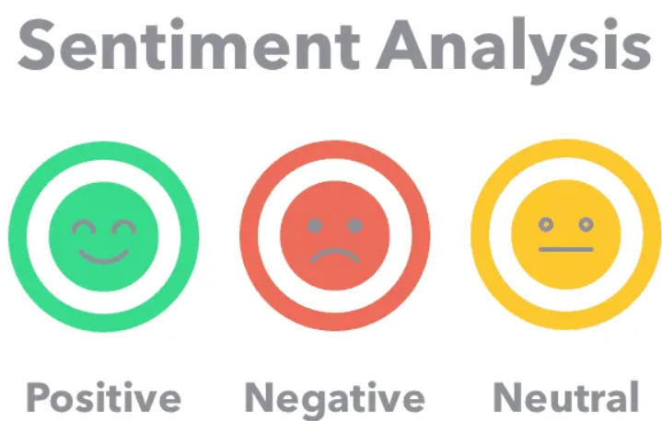
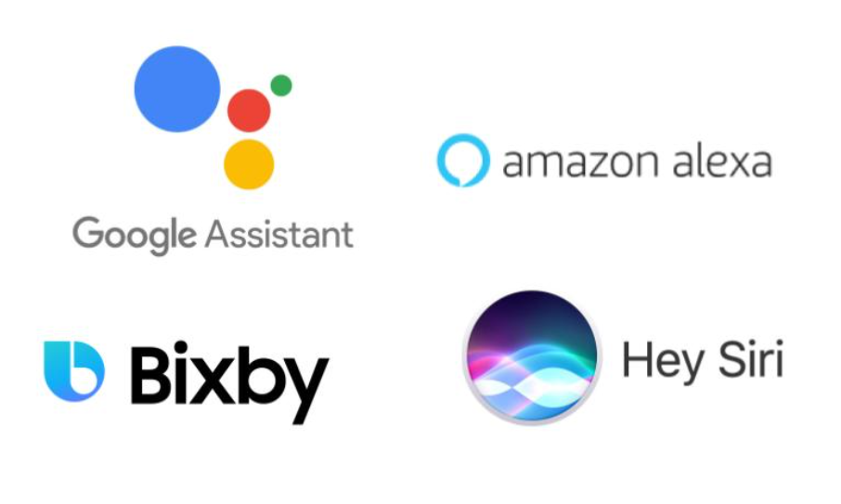

Application
Text Classification: Categorizing text into predefined labels
Machine Translation: Translating text from one language to another
Sentiment Analysis: Analysing positive or negative
Speech Recognition: Converting spoken language into text
Text Generation: Contextually related texts

Slide 6
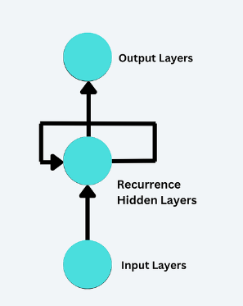
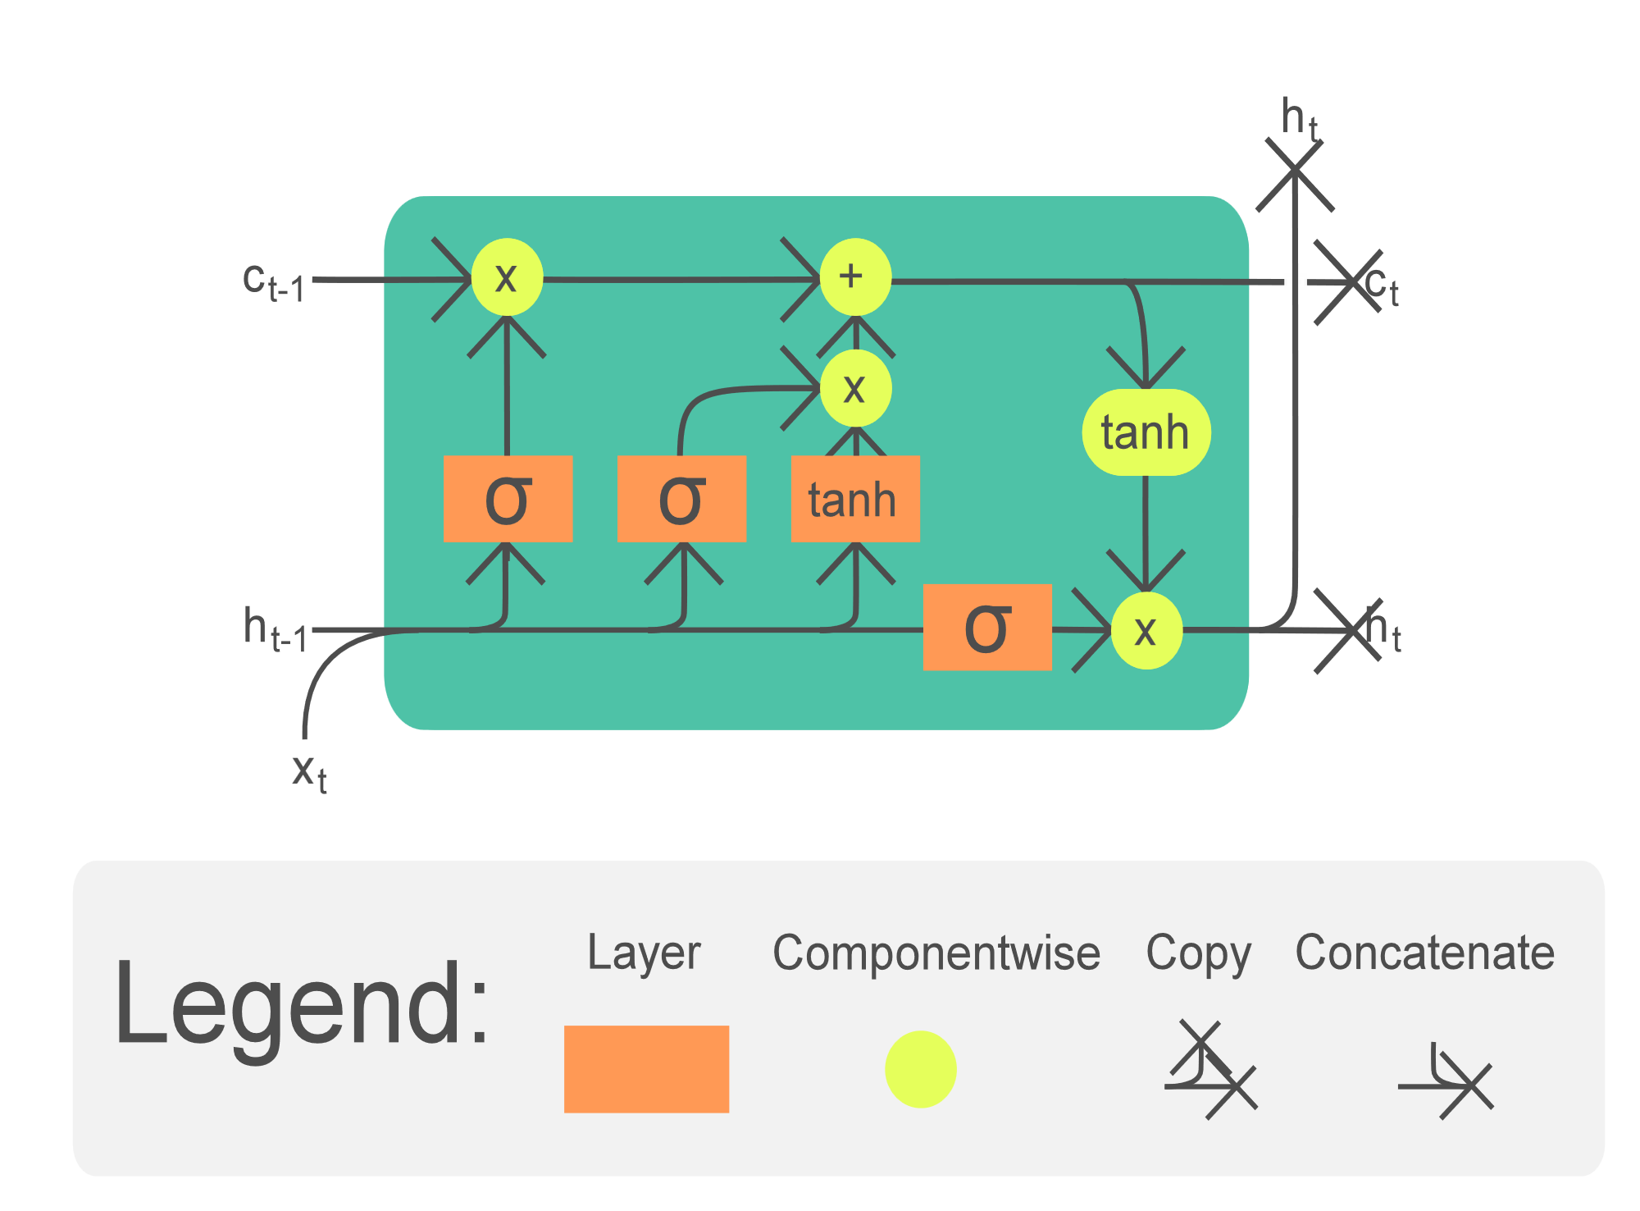
Deep Learning Models
RNNs (Recurrent Neural Networks): Handle sequential data and capture dependencies between words.
LSTMs (Long Short-Term Memory Networks): Mitigates the vanishing gradient problem and captures long-range dependencies.
Transformers: Use self-attention mechanisms to capture dependencies and parallelize training.

Slide 7
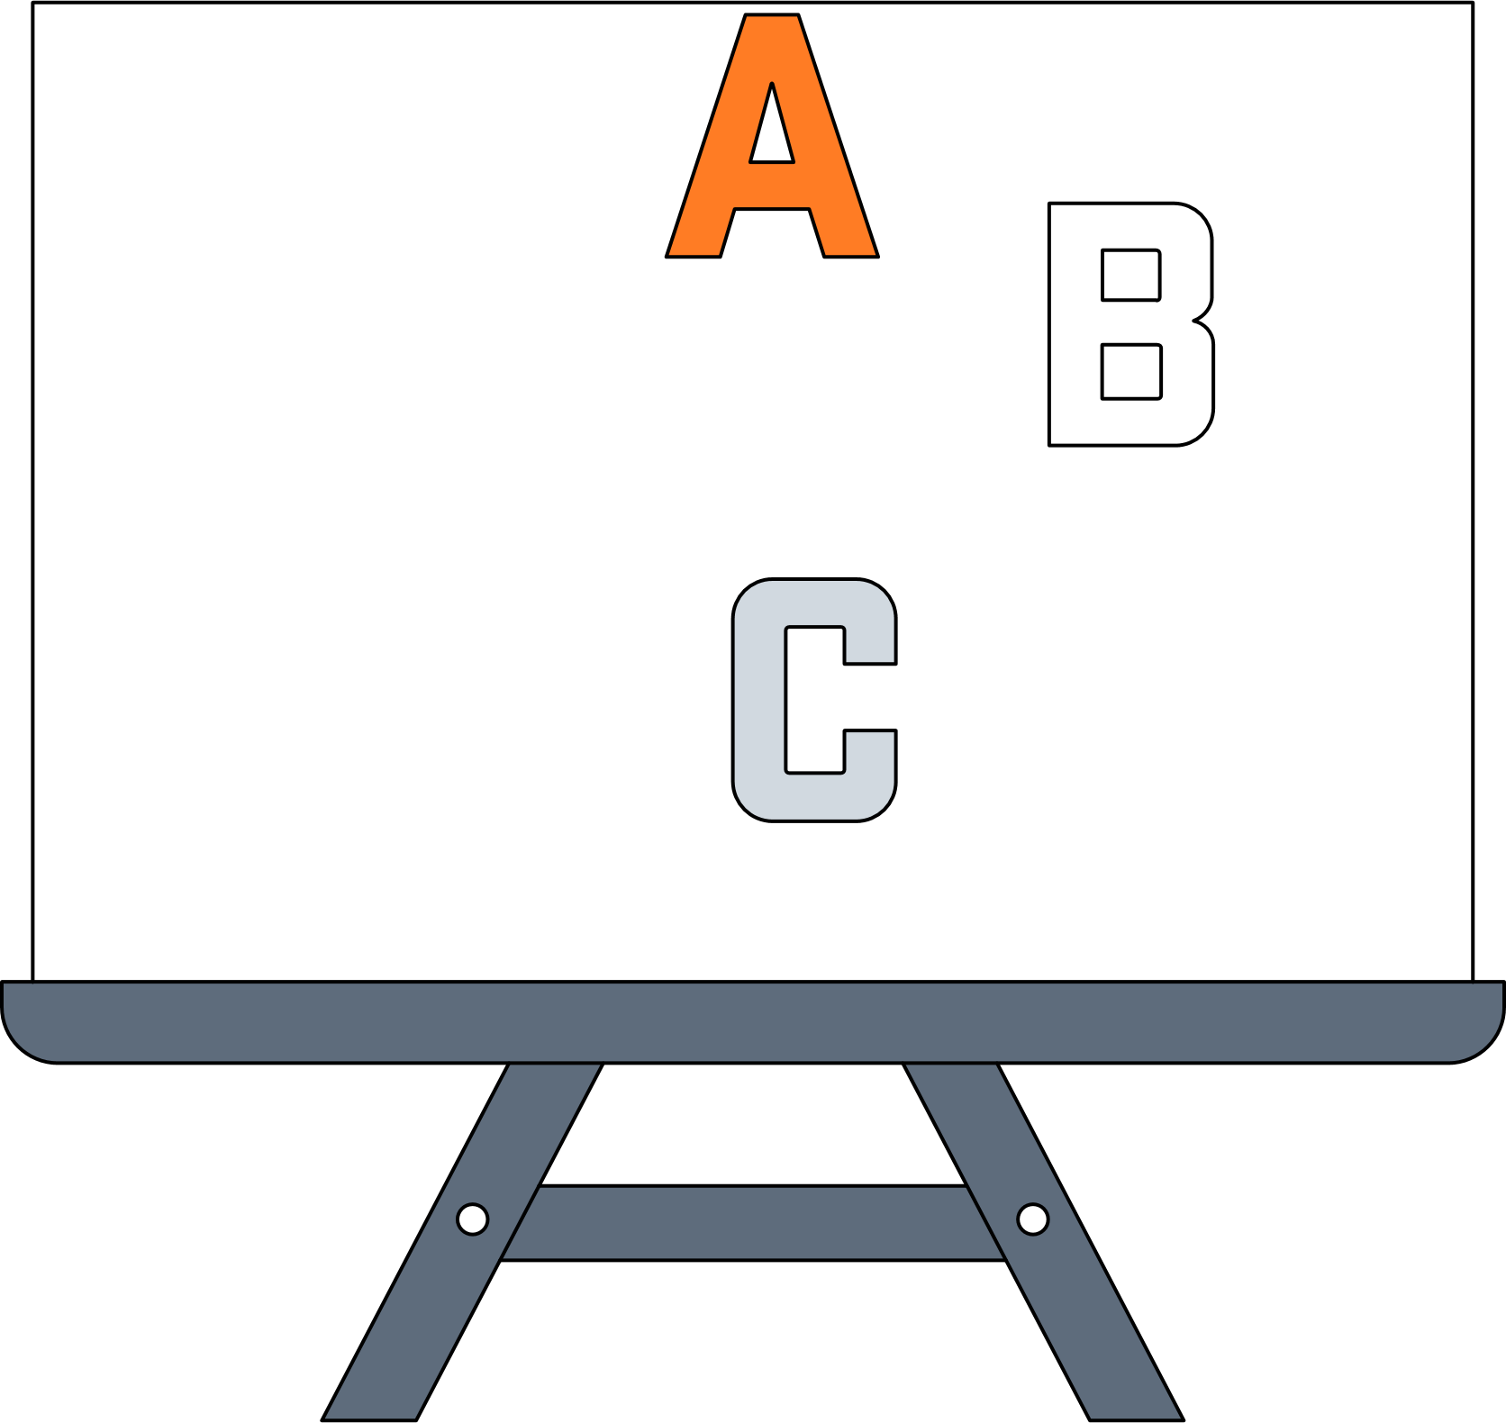

02
RNN 🙴LSTM
Overview丨About Us丨Our story丨Problem

Slide 8
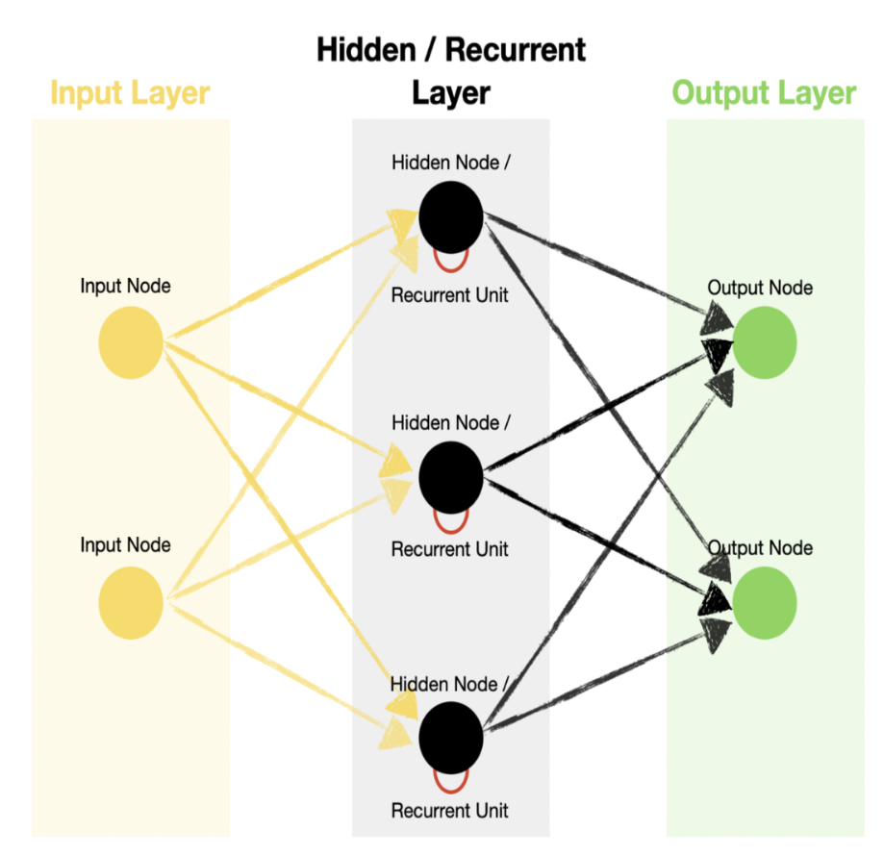
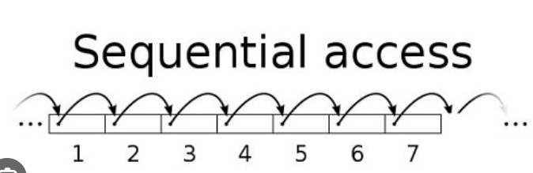
RNN overview
Structure: Networks with loops, allowing information
to persist.
Function: Designed for sequential data
Limitation: Struggle with long-term dependencies

Slide 9
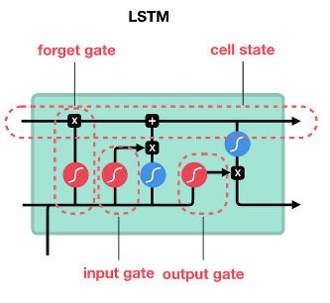
LSTM Overview
Structure: A type of RNN designed to remember information for long periods.
Components:
Cell State: Keeps track of the information over time.
Gates: Control the flow of information (input gate, forget gate, output gate).
Function: Effectively captures long-term dependencies by addressing vanishing gradient issues.
Benefits: Better performance in tasks like language modeling, machine translation, and time series prediction.

Slide 10
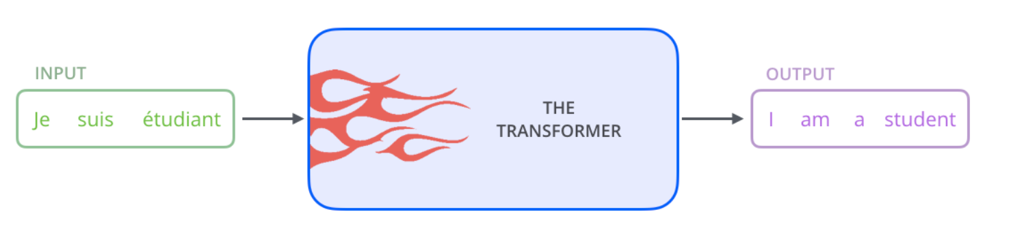
“Attention Is All You Need” - ‘Ashish Vashwani’
03
Transformer
Overview丨Encoder & decoder丨self-attention丨
Decoder

Slide 11
Overview
The Transformer model, introduced by Vaswani et al.
"Attention is All You Need" (2017)
Uses self-attention mechanisms to handle dependencies
Supports Parallel Processing
Long-Range Dependencies
eg. GPT & BERT

Slide 12
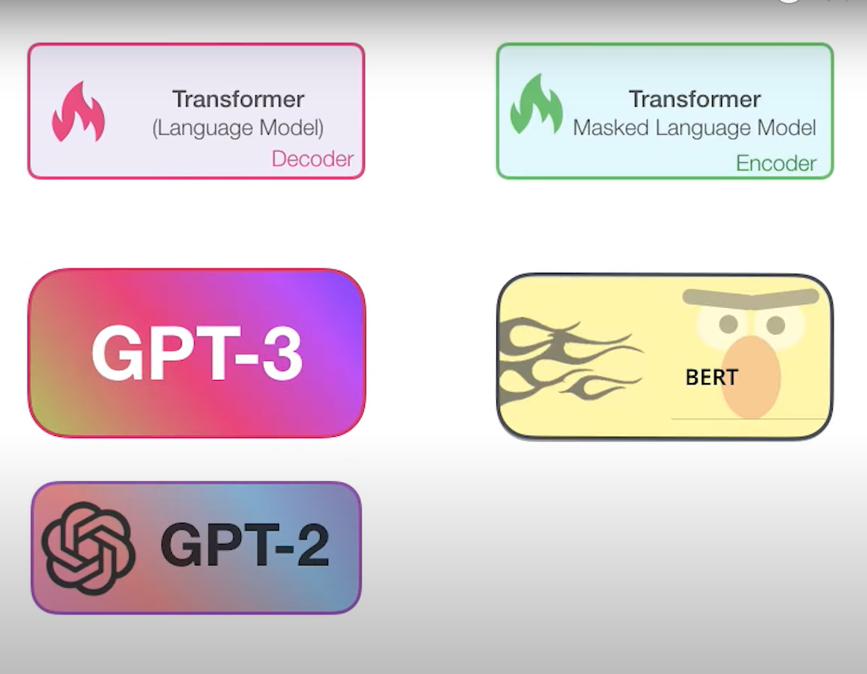
GPT and BERT
Transformer

Slide 13
“Attention Is All You Need” - ‘Ashish Vashwani’
04
Architecture
Overview丨Encoder & decoder丨self-attention丨
Decoder

Slide 14
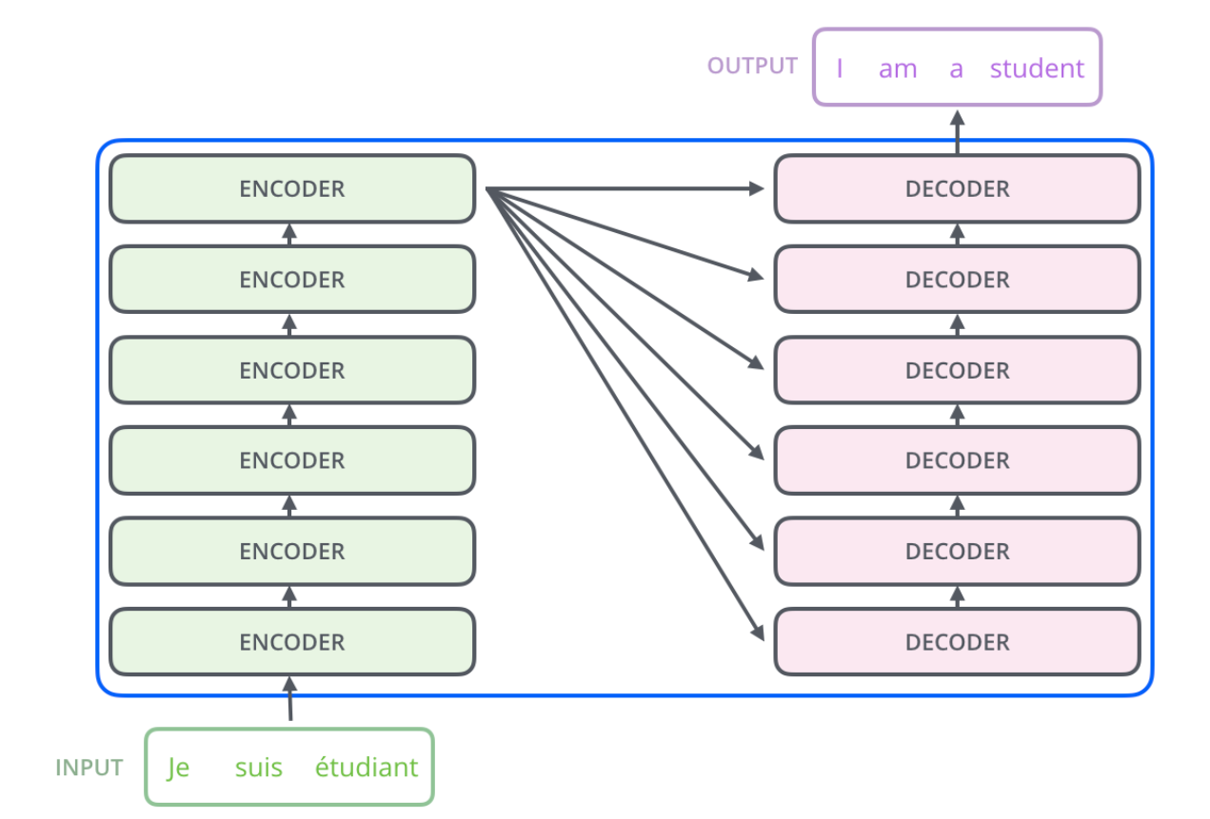
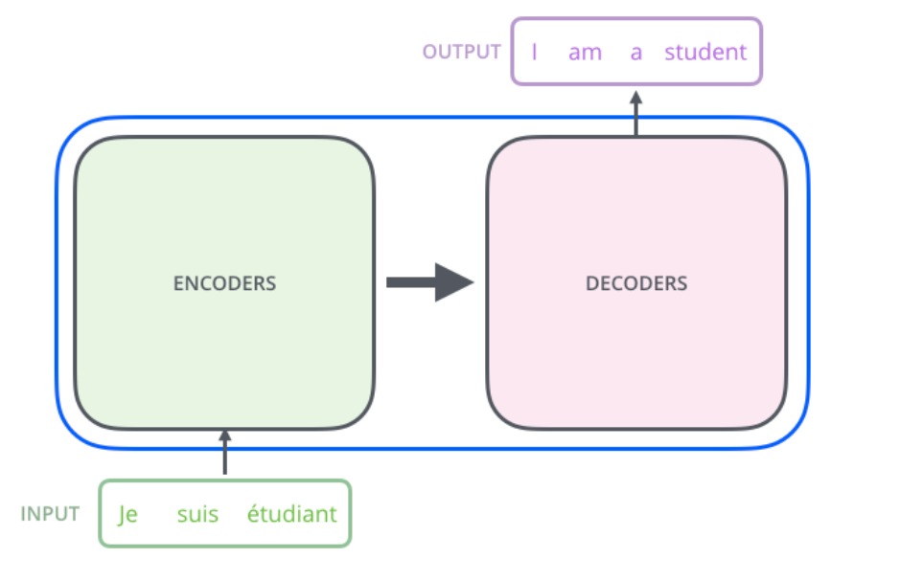
Encoder & Decoder

Slide 15
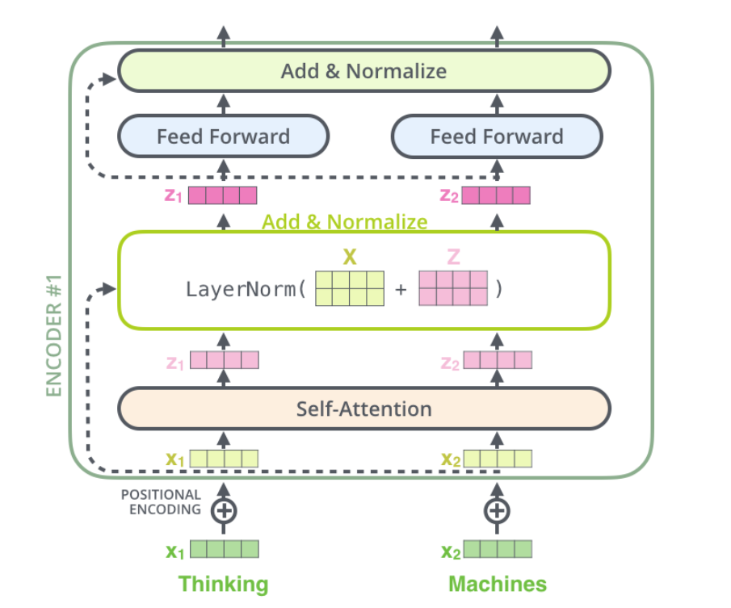
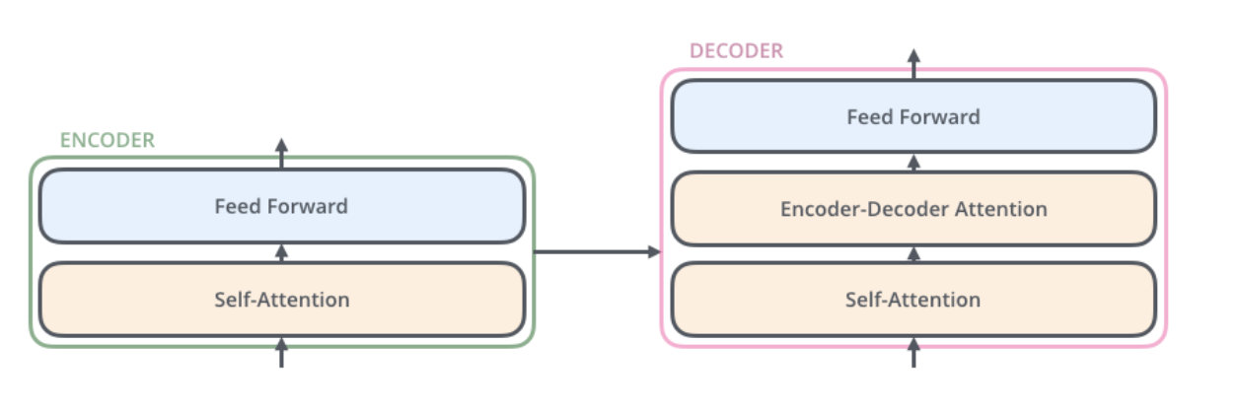

Slide 16
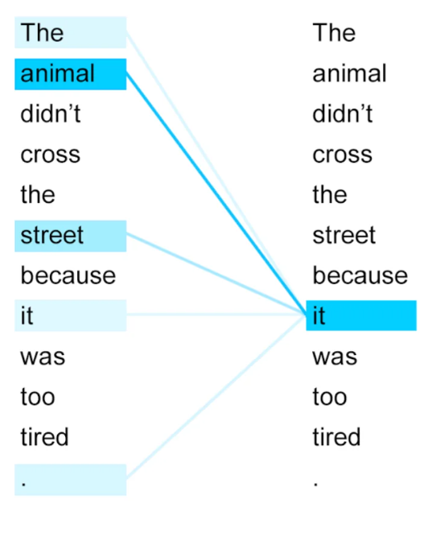
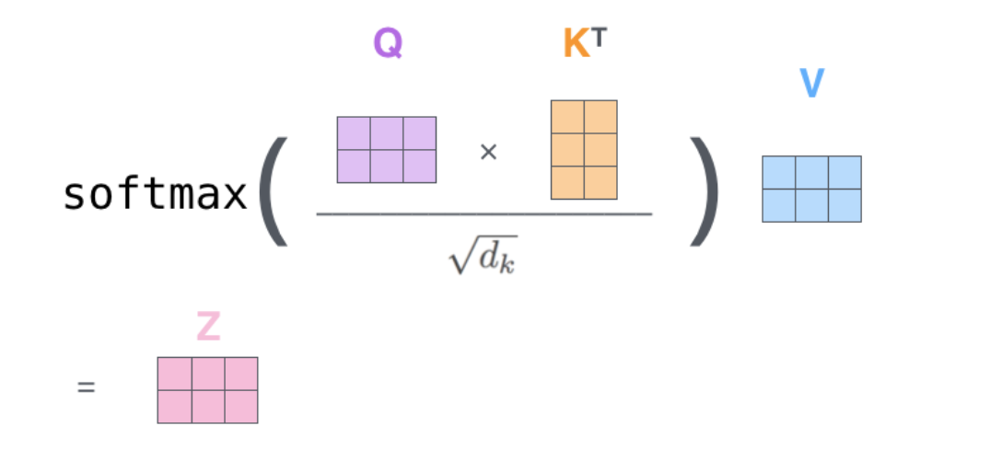
Self-Attention
Weigh the importance of different words in a sentence relative to each other, regardless of their position.
the animal didn’t cross the street because it was too busy

Slide 17
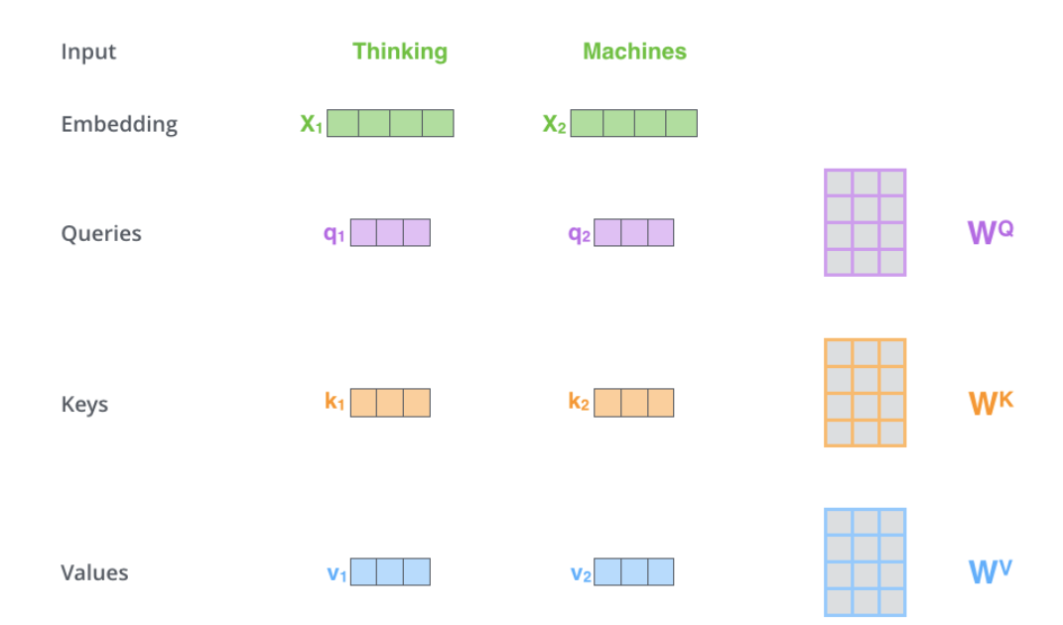
512
64
64
64

Slide 18
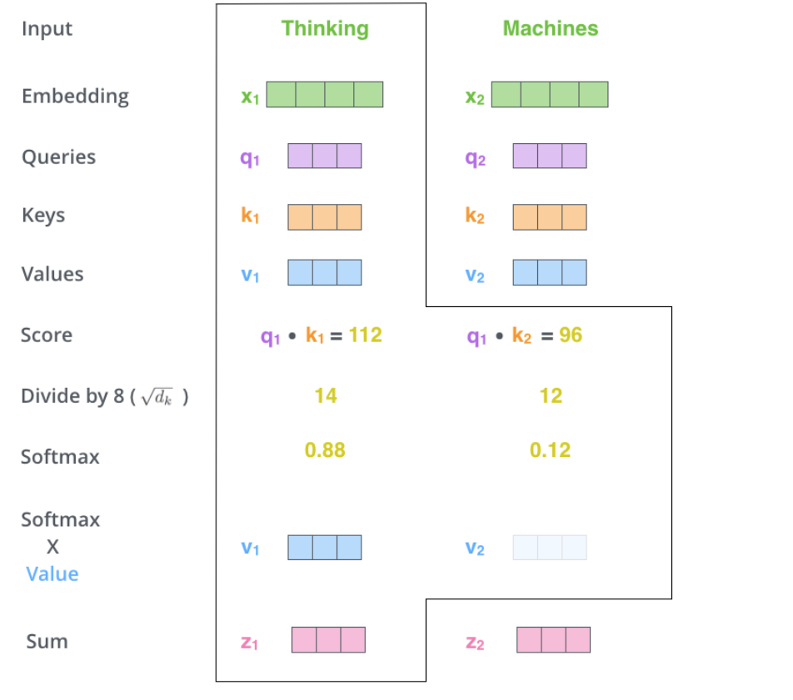
64

Slide 19
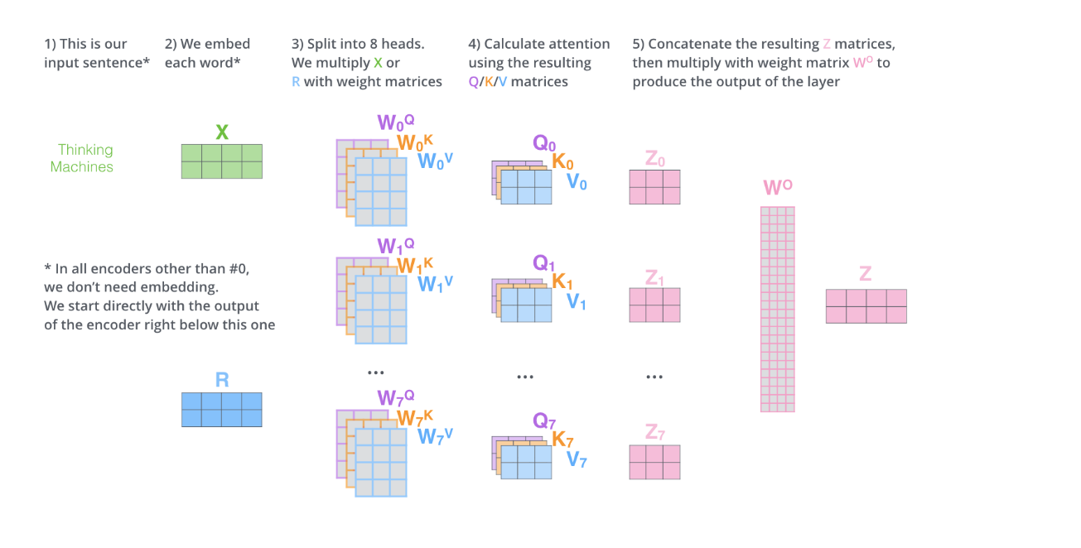
“multi-headed” ATTENTION
Enhance the understanding of
relationships between two word

Slide 21
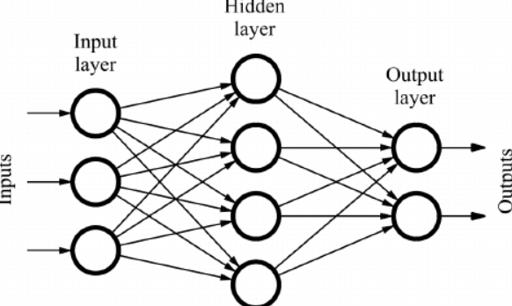
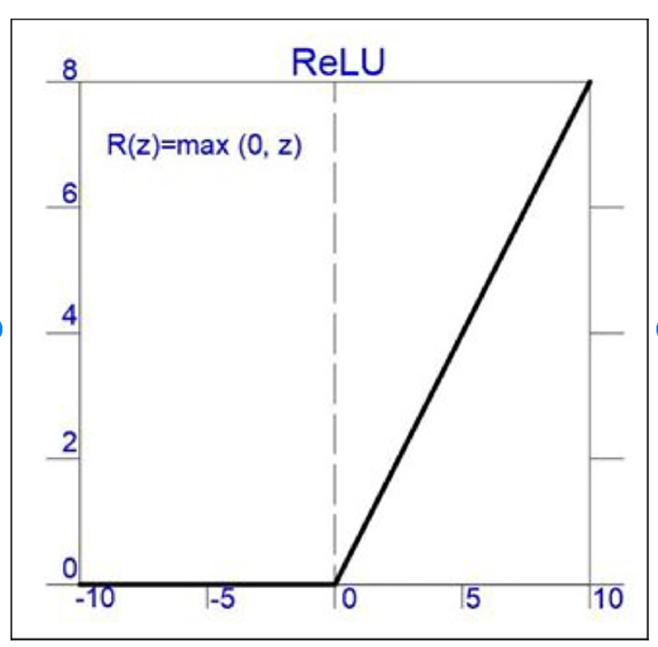
Feed Forward
Captures relationships between different
parts of input sequence
Transform input data into higher-dimensional space
Linear transformations followed by
non-linear activation function, typically (ReLU.)

Slide 22

DECODER

Slide 23
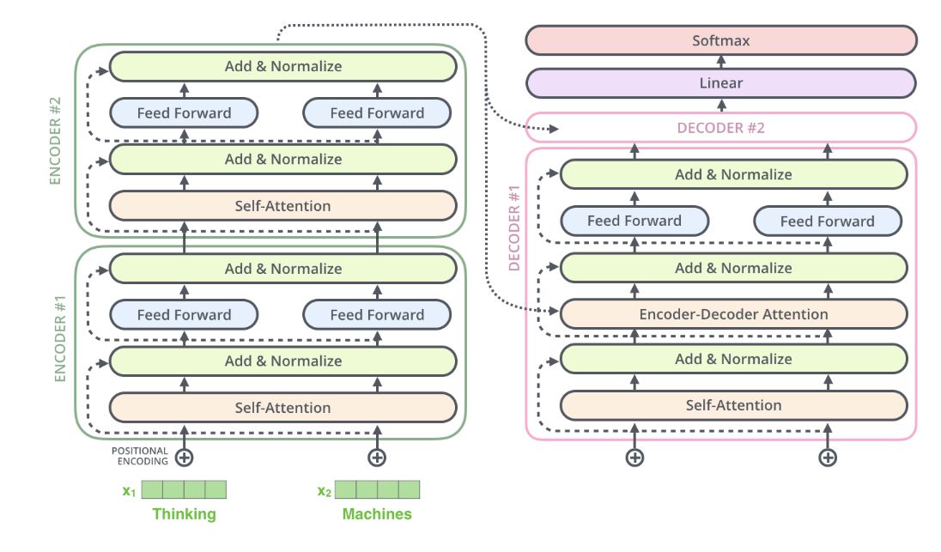
OVERALL
Softmax is normalization function used in multi-class classification problems. between (0-1)
Residual connection: Avoiding vanishing gradient problem,

Slide 24


DYSL-LAB intern
THANKS FOR WATCHING
BY : Arjun Pandey
Date:08/07/2024

